Slide 1

Openvuln scanner & SECURITY framework
“It takes 20 years to build a reputation and few minutes of cyber-incident to ruin it."
– Stephane Nappo

Slide 2
MEET OUR TEAM
MENTOR
Dr. SUGANTHI N
TEAM MEMBERS
SHARAT N
VISHAL S
RAJHESHWAR V

Slide 3
Project objective and scope of the project work
Our objective is to design a Security Framework for enterprise use. It is a GUI tool that takes user inputs and performs Open-Source Intelligence (OSINT) operation to generate a report of the various data collected using the respective tools.

Slide 4
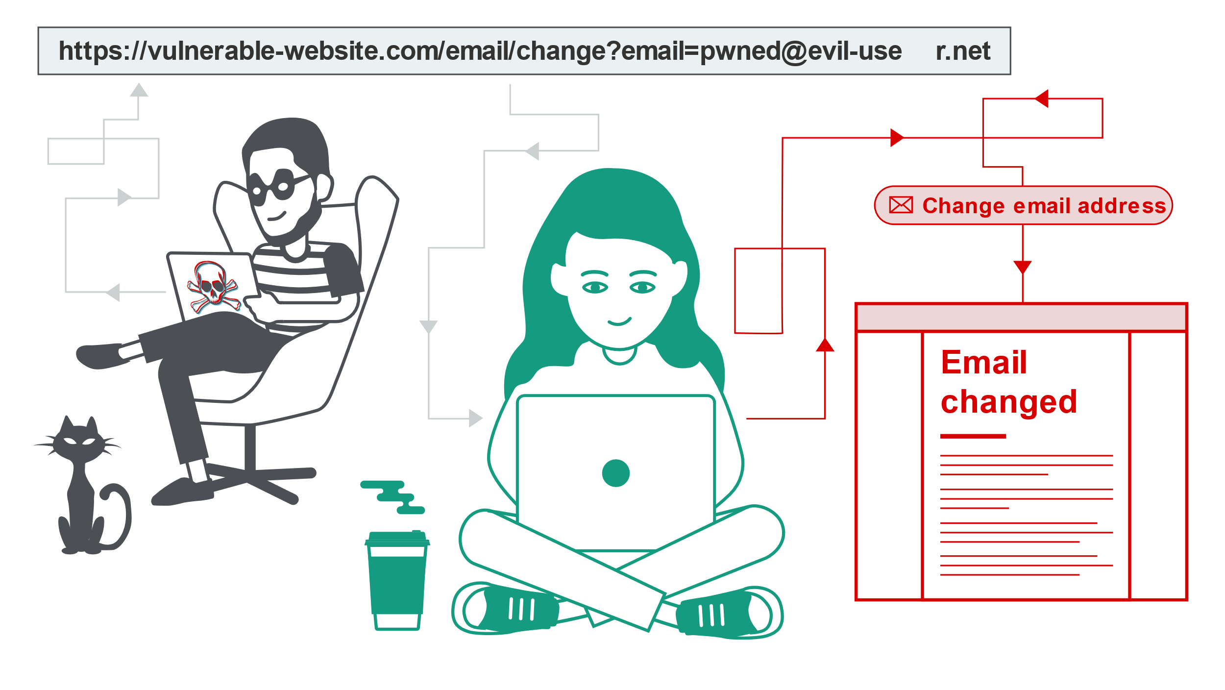
Introduction to area of the project
Many organizations activities operate via the internet this situation has further forced many organizations to use the internet for their daily operation, on the other hand, cybercriminals have gotten a chance for launching more attacks on many organizations.
Without the appropriate use of security, it leads to misconfiguration of network and deployment for vulnerable services, Which could lead to loss for the company with the advent of cyberattack in form of compromise of critical information stored in the organization systems. Hence, to prevent these damages, a viable framework is in demand. This project is based on Cybersecurity and security policies that should be followed in an Enterprise for safe functioning.

Slide 5
DRAWBACK OF EXISTING SOLUTION
No Single Comprehensive Tool
Expensive Commercial Tools
Free Tools with limitations
Lack of Integrated Framework

Slide 6
Innovation
Providing an open-source framework and generating an API for fetching the attacker's details specifically
Scripting the module architectures and interactive user interfaces
Integrating tools in a strategical manner which works in a well-structured flow in information gathering and attacker tracking
Performing malware analysis may provide us with additional information about the attacker such as backdoor information which can be used to trace the foot-prints of the attacker
Predicting the attacker's public identity such as username, location, IP, reverse number lookup, and email using social platforms

Slide 7
Functional Features
Email Header Analyzer
URL examination and Data Gathering
Location and mobile number tracker
DNS and IP address lookup
Network scanner
Malware Analyzer
Image Metadata Analyzer
Report Generation

Slide 8
Details of the Proposed system
A framework that adheres to the International standards on network configuration and information management.
A GUI tool that provides an easy-to-use interface to assist the security standards in an organization with respected to our framework standards.
It culminates in the betterment of the security of the college/Enterprise using it.

Slide 9
SECURITY FRAMEWORK
CIA Triad
Periodic Risk Assessment
Information Access Management
Workforce Management
Datacenter and Device Security
Audit

Slide 10
MODULES
Network scanner
Domain details fetcher
SSL Certificate Details
OS Detection
Subdomain Enumeration
DNS, IP lookup
Geolocation of IP
Email Header Data Extraction
EXIF Metadata Analysis
Malware Metadata Extraction

Slide 11
Architecture
Email Header Analyzer
URL and Network Analyzer
Malware Analyzer
Image Metadata Analyzer
Extract IP Addresses
Extract Domain Name
Creation time
Extract Username
Extract File Path
Extract Email Addresses
Network scanner
Domain details fetcher
SSL Certificate Details
OS Detection
Subdomain Enumeration
DNS, IP lookup
Geolocation of IP
File type identifier
Target OS
File Format
Malware Hash examine
Malware metadata extraction
Strings analyzer
File type identifier
Target OS
File Format
Malware Hash examine
Malware metadata extraction
Strings analyzer

Slide 12
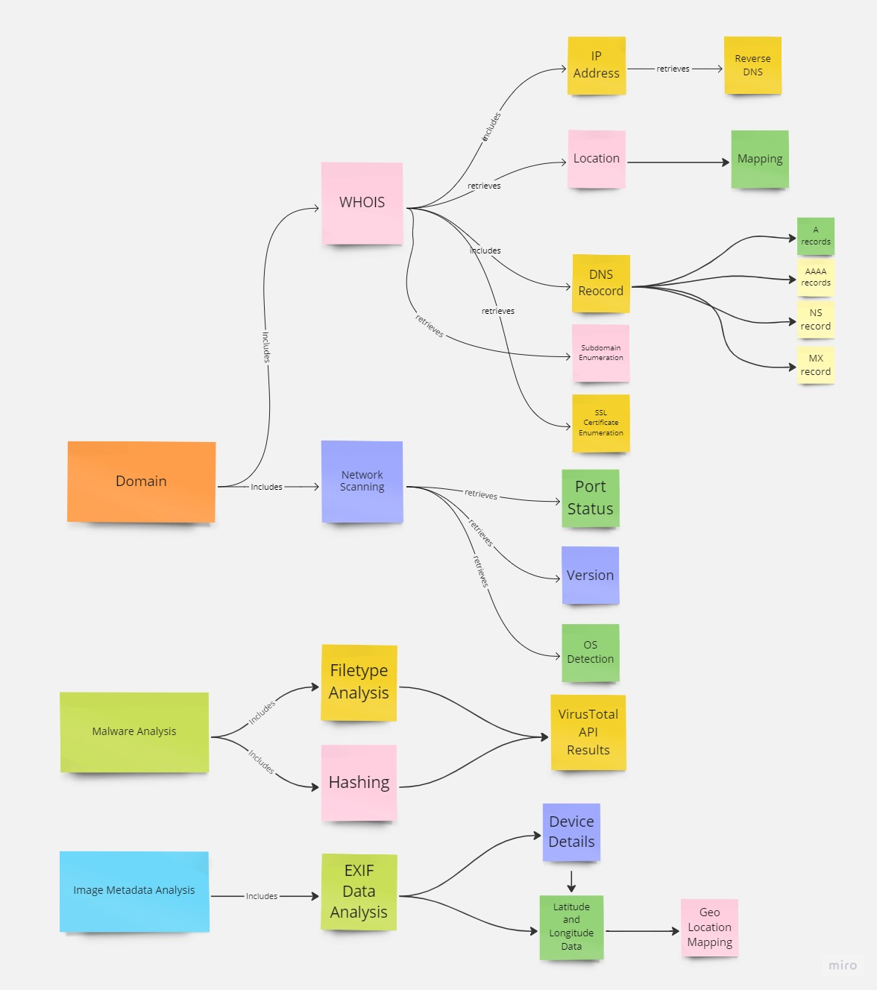
BLOCK DIAGRAM OF OSINT TOOL

Slide 13
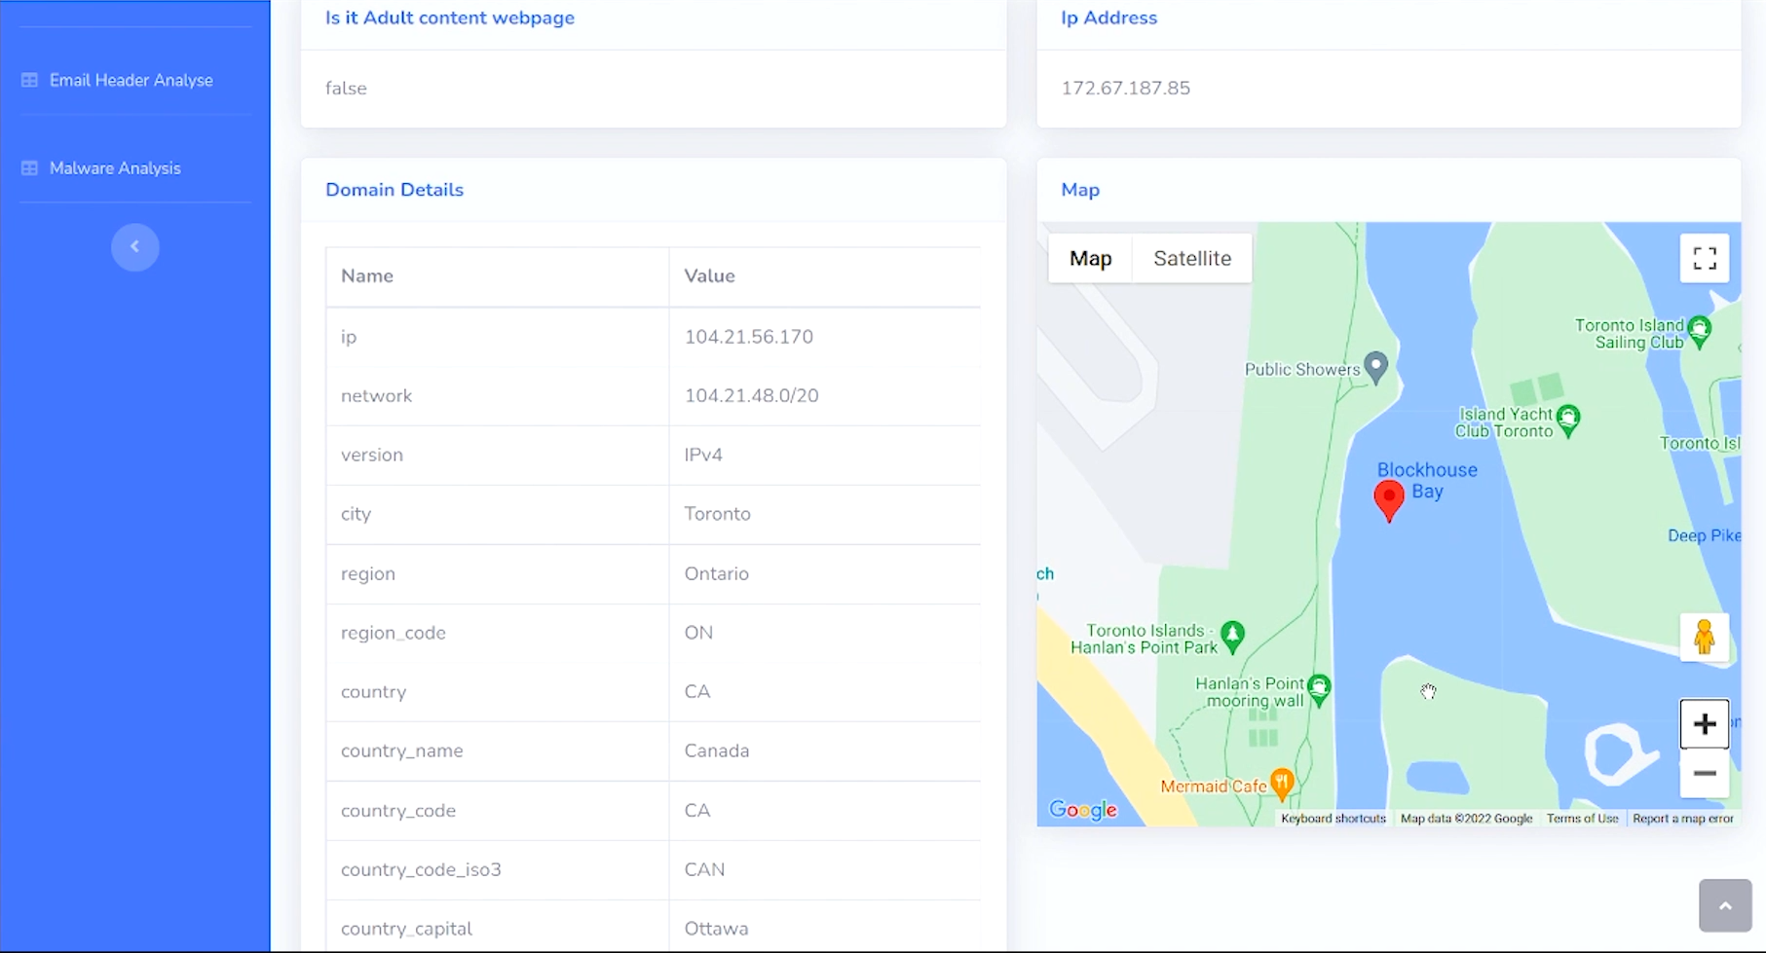
MAIN DASHBOARD

Slide 14
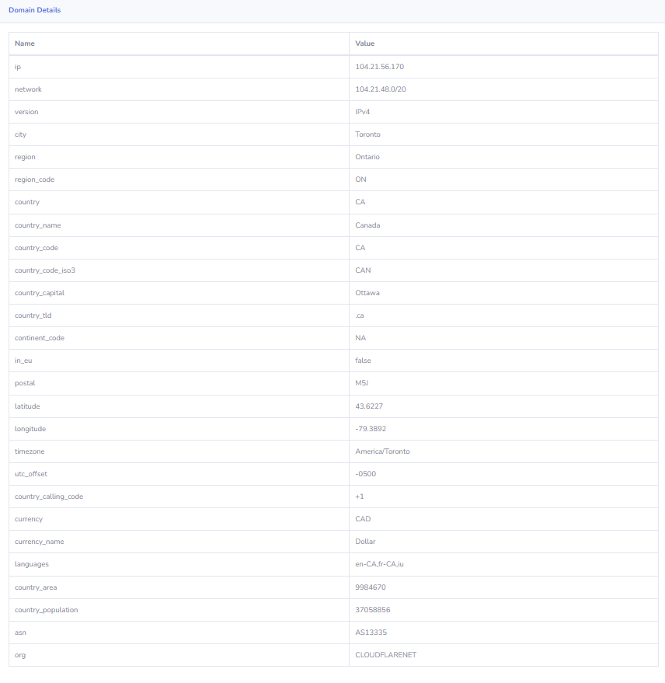
WHOIS Details

Slide 15
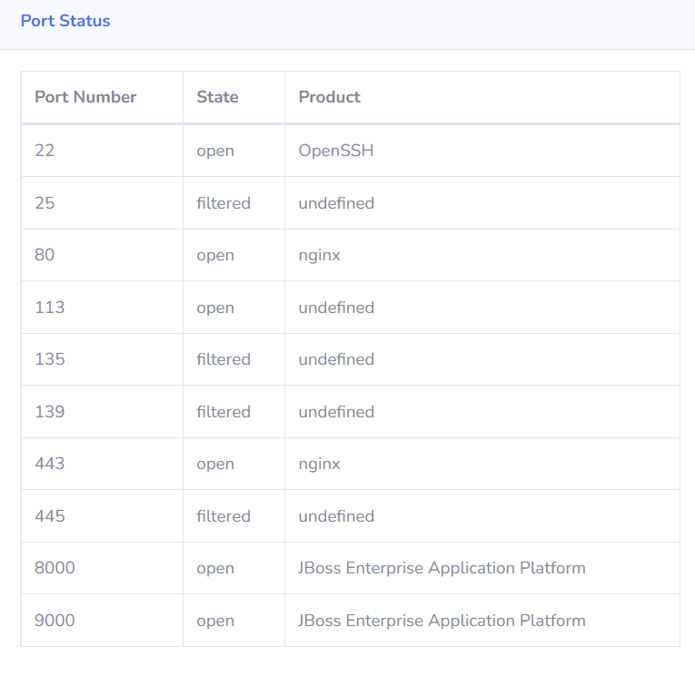
NMAP PORT SCAN

Slide 16
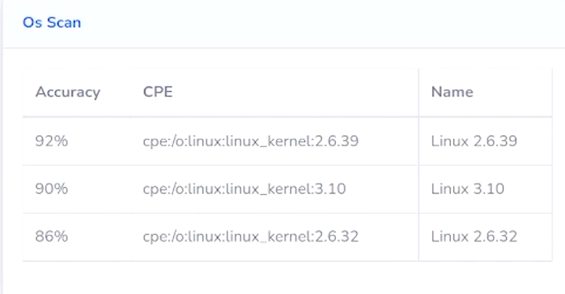
OS DETECTION

Slide 17
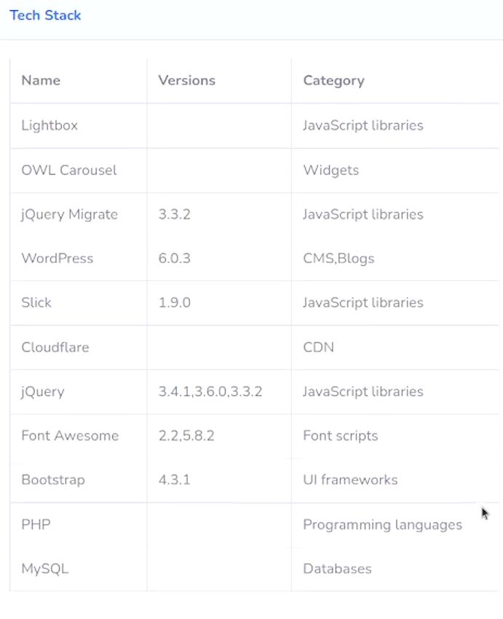
TECHNOLOGY STACK ENUMERATION

Slide 18
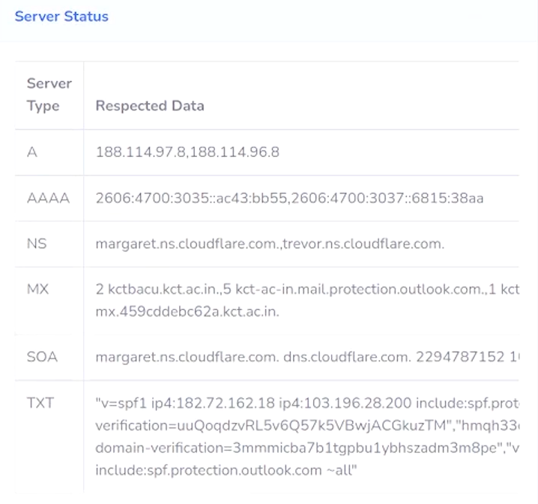
DNS ENUMERATION

Slide 19
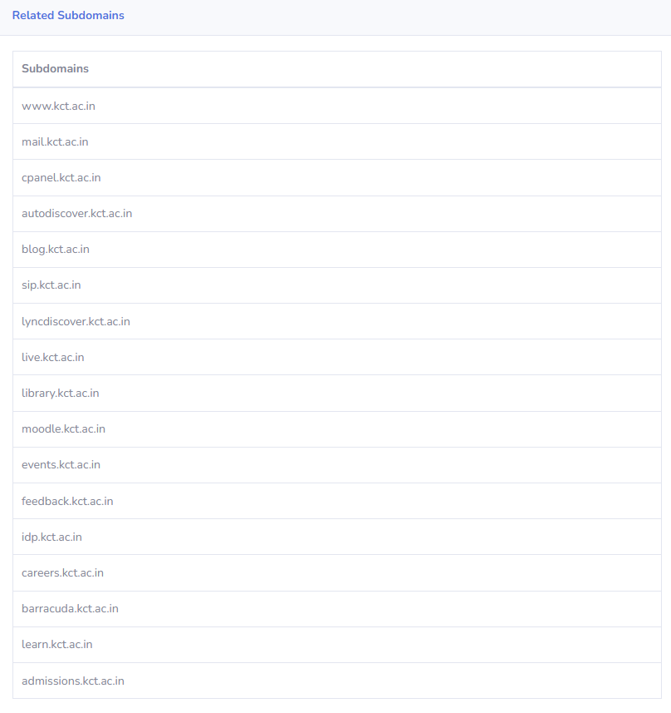
SUBDOMAIN ENUMERATION

Slide 20
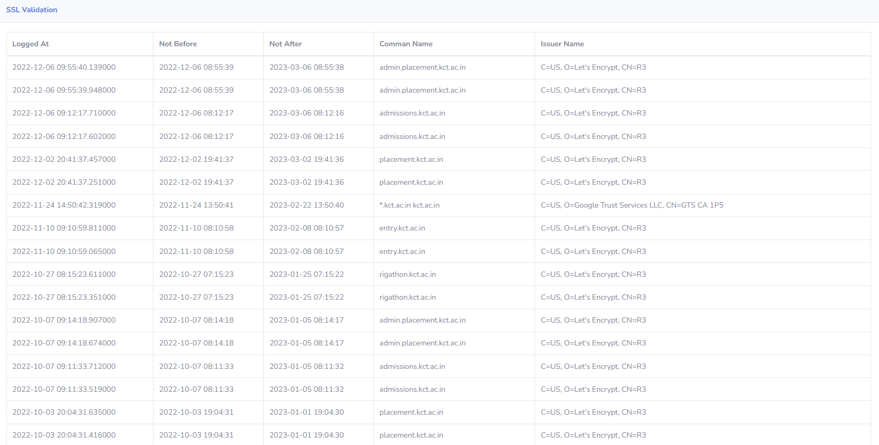
SSL CERTIFICATE ENUMERATION

Slide 21
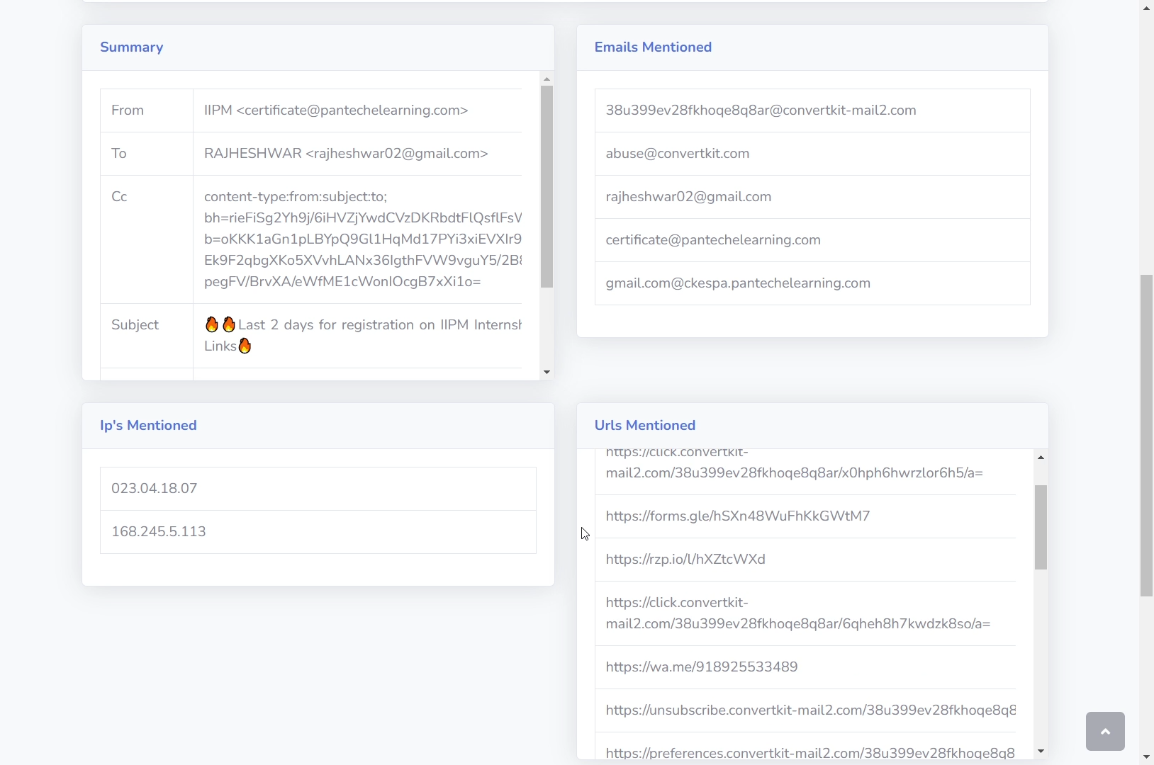
EMAIL HEADER ANALYSIS

Slide 22
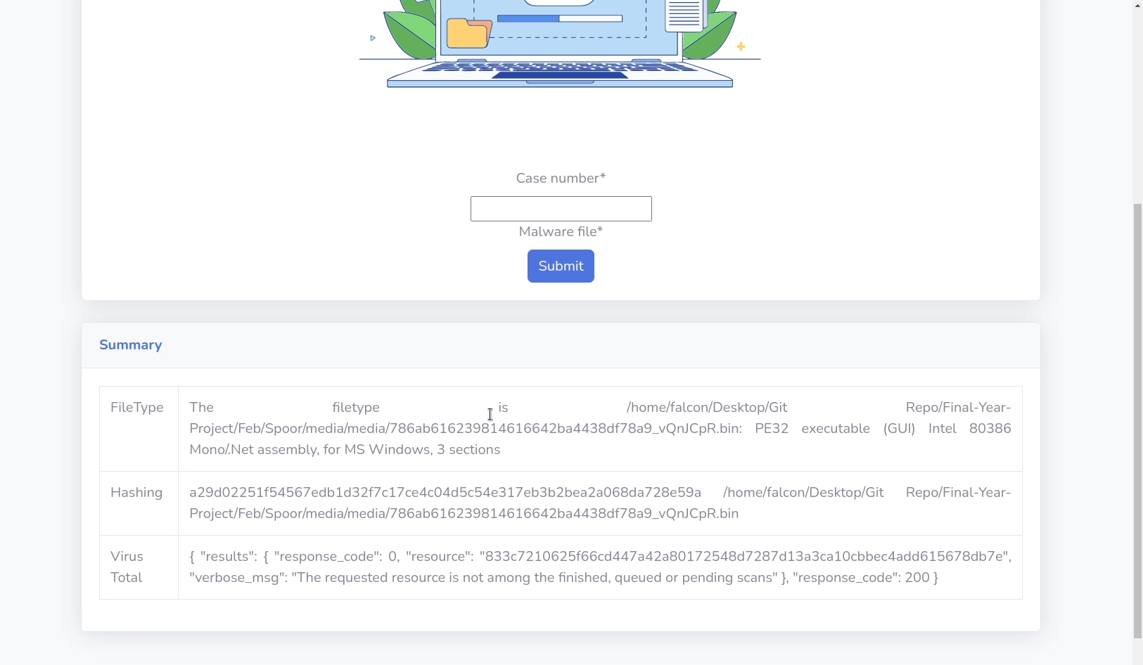
MALWARE ANALYSIS

Slide 23
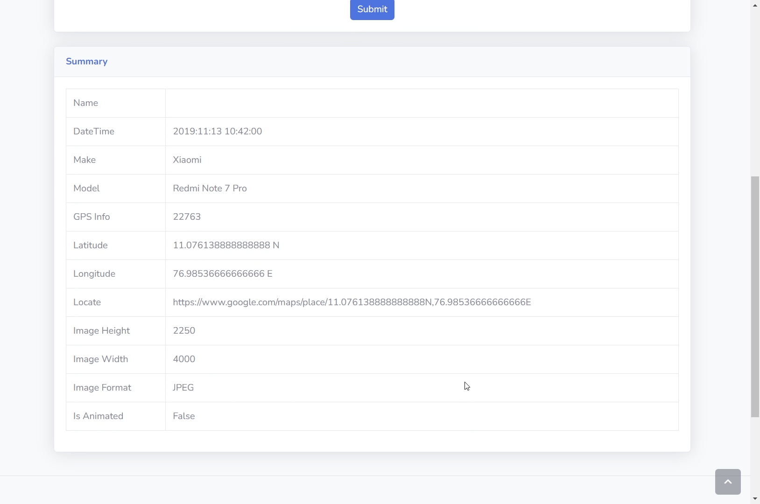
IMAGE METADATA ANALYSIS

Slide 24
TECHNOLOGY STACK
LANGUAGES
Python
HTML
CSS
JS
Bash
API
IP API
Wappalyzer
DNS For Family
Virus Total
Python Packages
Py-Nmap
DNS Resolver
Pycrtsh
ExifRead
FRAMEWORK
Django

Slide 25
ADVANTAGES
Feasible
Time efficient for Report Generation
Low-cost maintenance
Less resource consumption
Works in a very strategical manner

Slide 26
DISADVANTAGES
Comprehensive OSINT needs more time
Dependent Modules

Slide 27
LITERATURE SURVEY
NIST Framework
NIST places a strong emphasis on utilising business objectives to direct cybersecurity efforts and taking cybersecurity risks into account as part of the organization's risk management procedures. When it comes to managing cybersecurity risk for critical infrastructure, there is no one solution that fits all. Organizations will still face distinct risks from various threats, vulnerabilities, and risk tolerances. They will also differ in how they adapt the Framework's recommended practises. [1]

Slide 28
LITERATURE SURVEY
Controlled Unclassified Information (CUI)
Federal agencies place a high priority on protecting Controlled Unclassified Information (CUI) stored in non-federal systems and organisations. In this paper, federal agencies are given suggested security standards for safeguarding CUI confidentiality. Federal agencies are expected to use the standards in contracts and other legal documents. It offers federal agencies suggested security standards for safeguarding the CUI in a system and organisation that are not federal. [2]

Slide 29
LITERATURE SURVEY
Cybersecurity Workforce Framework (NICE Framework)
The Cybersecurity Workforce Framework (NICE Framework), developed by the National Initiative for Cybersecurity Education (NICE), is a model for reference that explains the interdisciplinary nature of cybersecurity work. It acts as a key reference tool for outlining and exchanging knowledge about cybersecurity work and the knowledge, skills, and abilities (KSAs) required to finish projects that can improve an organization's cybersecurity posture.

Slide 30
LITERATURE SURVEY
Open-Source Intelligence (OSINT) - METHODOLOGY
Open-Source Intelligence (OSINT) is the gathering of information from publicly accessible, private and public sector sources about specific people or an organization for business intelligence objectives. These sources include the internet, emails, Twitter, Facebook, and other social media websites and apps. The risks, weaknesses, and effects of using social media sites have been the subject of much discussion and research, but this study aims to reduce prejudice. [8]

Slide 31
CONCLUSION AND FUTURE WORKS
Extensive OSINT Tool
Framework which includes Network Security, Application Security will be added
Performance Optimization

Slide 32
THANK YOU

Slide 33
CONNECT US THROUGH

